Slide 1

Smart Deploy (Bench resource reporting)
Team Members:
M.G.K.M.Sai Seeta
Alisha Mallick
Simran Kumari
Y. Venkata Rama rao
Shubham Jain

Slide 2
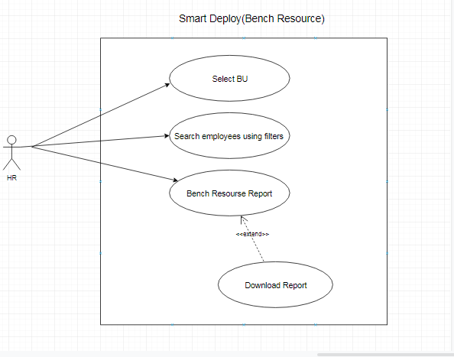
Case Study :
use-case diagram
Bench Resource will give Resource Managers a view to see all bench resources status, whether on bench or selected to fulfill a demand.
Details are shown in pie, bar and line charts.
A detailed report is shown on click of charts.

Slide 3
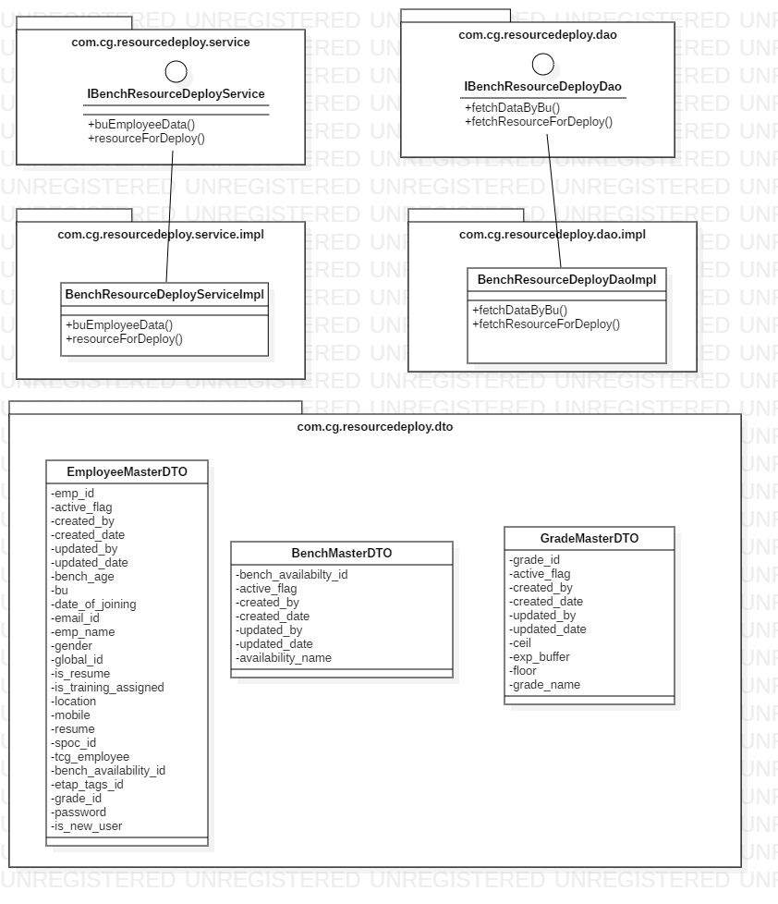
Class diagram :

Slide 4
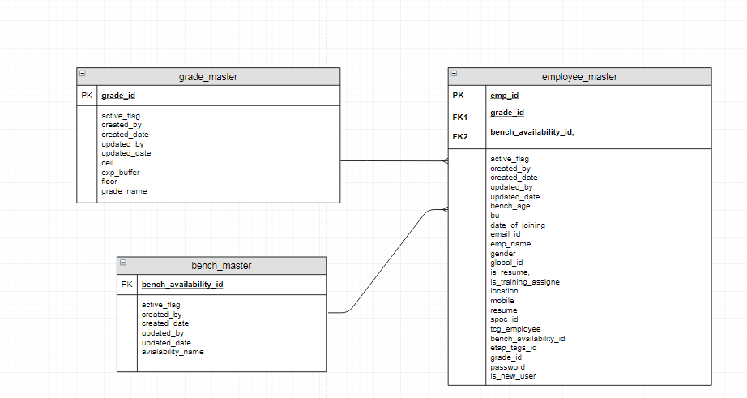
ER diagram :

Slide 5
Block Diagram:
UI
(angular)
Back end Service
request
Controller
Database
Service Layer
response
Request data
Dao
User
Send data

Slide 6
Technology used:
Spring Boot -2.1.6.release
Angular 8
Oracle 10xe
Highcharts

Slide 7
Enter the Bu name
After selecting BU name a pie chart is shown as below
A table is shown in dialog box after clicking on pie chart which is
sortable by all fields i.e empid, name, email, grade, location, status .
A filter can be applied on grade and location and fullfilment.
A button is shown below the table to download filtered data in excel format.
empId | Name | Email | Grade | Location | Fullfilment
001 | abc | abc@capgemini.com | D | Chennai | Not deployed
002 | xyz | xyz@capgemini.com | C | Hyderabad | deployed

Slide 8
Bar chart and graph are generated based on selected employees

Slide 9
MVP(Minimum Viable Product)
MVP 1 | MVP 2 | MVP 3 | MVP 4
Display data in pie chart, line, bar charts | Display the table in dialog box and apply filters on table | Download the data in excel sheet format | Deploy whole product in cloud
8/8/2019 - 9/8/2019 | 10/8/2019-12/8/2019 | 13/08/2019-13/08/2019 | 14/08/2019-14/08/2019

Slide 10
Thank You

